Slide 1

Applied Uses of Blockchain:
Presented by: Michael Young, CTO

Slide 2
What Paycase Does:
Why
Responsible Finance for Everyone
How
Social banking that enables the movement of money
using non-traditional cash settlement mechanisms
What
Universal mobile banking (Apple IOS and Android), transparent money transmittance, same day settlement, global last mile delivery
Notes:
To build a highly flexible, low cost, and scalable mobile bank (no physical infrastructure or retail outlets)
Connect the world’s money – send money to anyone, anytime, anywhere, and immediately at low rates
Constantly add value to banking customers by proactively providing additional services, all online
Elevator Pitch
Momentum, Traction, Expertise: Your key numbers
Market Opportunity: Define market size & your customer base
Problem & Current Solutions: What need do you fill? Other solutions
Product or Service: Your solution
Business Model: Key Revenue Streams
Market Approach & Strategy: How you grow your business
Team & Key Stakeholders (Investors, Advisors)
Financials
Competition
Investment: Your ‘Ask’ for funding, Basic use of funds

Slide 3
Value Elements of Blockchain
Immutable Information/Data
Continuity of Events / Audit Trail
Decentralized Trust and Operation (Open)
Enhanced Trust (Closed)
3rd Party Witness
Notes:
To build a highly flexible, low cost, and scalable mobile bank (no physical infrastructure or retail outlets)
Connect the world’s money – send money to anyone, anytime, anywhere, and immediately at low rates
Constantly add value to banking customers by proactively providing additional services, all online
Elevator Pitch
Momentum, Traction, Expertise: Your key numbers
Market Opportunity: Define market size & your customer base
Problem & Current Solutions: What need do you fill? Other solutions
Product or Service: Your solution
Business Model: Key Revenue Streams
Market Approach & Strategy: How you grow your business
Team & Key Stakeholders (Investors, Advisors)
Financials
Competition
Investment: Your ‘Ask’ for funding, Basic use of funds

Slide 4
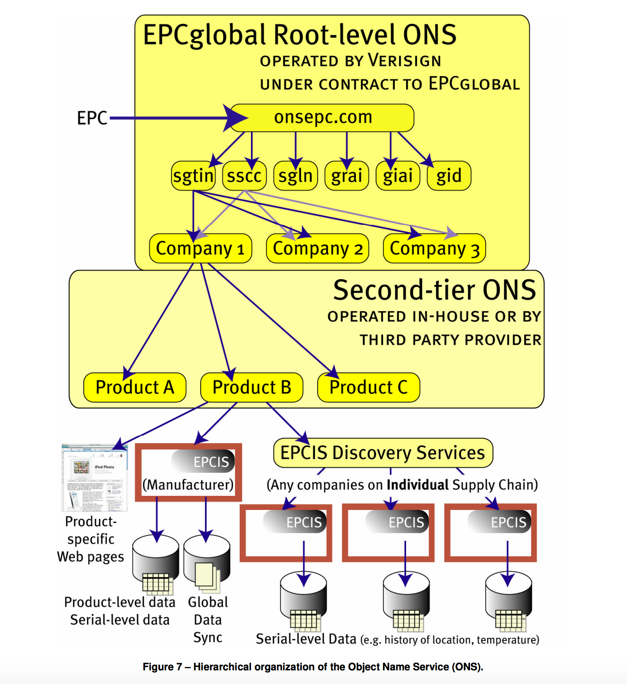
Old Problems,
New Approaches
Source: http://aero-id.org/research_reports/AEROID-CAM-001-Pedigree.pdf

Slide 5
Planes, Trains and Automobiles
Jet Engines typically need a full rebuild every 6-10,000 hours
Planes are in service for over 30 years, some much longer
Between changes in ownership, maintenance providers and re-certifications, pedigree documentation on a plane engine can easily involve hundreds of entities that touch that engine
Those critical items such as plane engines, train brake systems live so long the recording technologies can change multiple times.

Slide 6
Drug and Food Safety:
Tracking legitimate versus counterfeit pharmaceuticals are a challenge due to large global distribution networks, in an hierarchal model it’s the complex system problem.
Food distribution has a similar expansion problem, a single cow could reside on multiple sites, be exposed to many transportation components and after the kill floor be distributed to many stores. Now add cross-contamination from other animals and you have an exponential more difficult time ordering a system.
However, both drug and food distributions are formed in channels. Something we can shape a blockchain around.

Slide 7
Back to the value elements:
Immutable data is key to a jet engine that could be in service long after its original airline and numerous mechanical service shops are out of business
Continuity and audit trail is critical for drug and meat traceability pedigree
Decentralized trust becomes valuable when data could or must be changed/added to by an unknown and potentially larger number of participants (food distribution)

Slide 8
You can reach me at michael@paycase.com
Michael Young
Notes:
To build a highly flexible, low cost, and scalable mobile bank (no physical infrastructure or retail outlets)
Connect the world’s money – send money to anyone, anytime, anywhere, and immediately at low rates
Constantly add value to banking customers by proactively providing additional services, all online
Elevator Pitch
Momentum, Traction, Expertise: Your key numbers
Market Opportunity: Define market size & your customer base
Problem & Current Solutions: What need do you fill? Other solutions
Product or Service: Your solution
Business Model: Key Revenue Streams
Market Approach & Strategy: How you grow your business
Team & Key Stakeholders (Investors, Advisors)
Financials
Competition
Investment: Your ‘Ask’ for funding, Basic use of funds

